Slide 1
Sugar ring torsions
Pseudo rotation

Slide 2
papers
Altona, C., and M. Sundaralingam. “Conformational Analysis of the Sugar Ring in Nucleosides and Nucleotides. New Description Using the Concept of Pseudorotation.” Journal of the American Chemical Society 94, no. 23 (November 1, 1972): 8205–12. https://doi.org/10.1021/ja00778a043.
Li, Li, and Jack W. Szostak. “The Free Energy Landscape of Pseudorotation in 3′–5′ and 2′–5′ Linked Nucleic Acids.” Journal of the American Chemical Society 136, no. 7 (February 19, 2014): 2858–65. https://doi.org/10.1021/ja412079b.

Slide 3
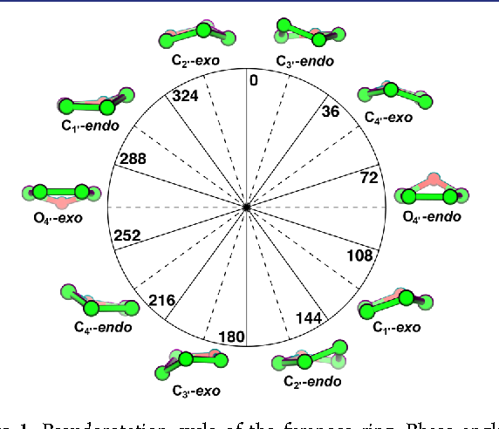
Pseudo rotation cycle of the furanose ring. C2’-endo =150° ; C3’-endo= 15°
Ref : Li, et al., J. Am. Chem. Soc. 2014, 136 (7), 2858–2865.

Slide 4
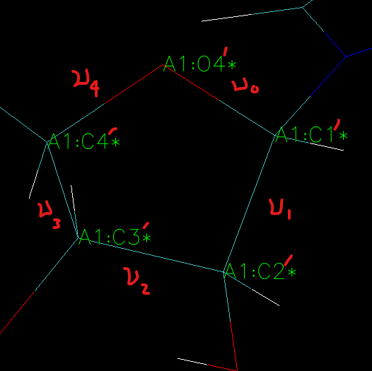


Slide 5
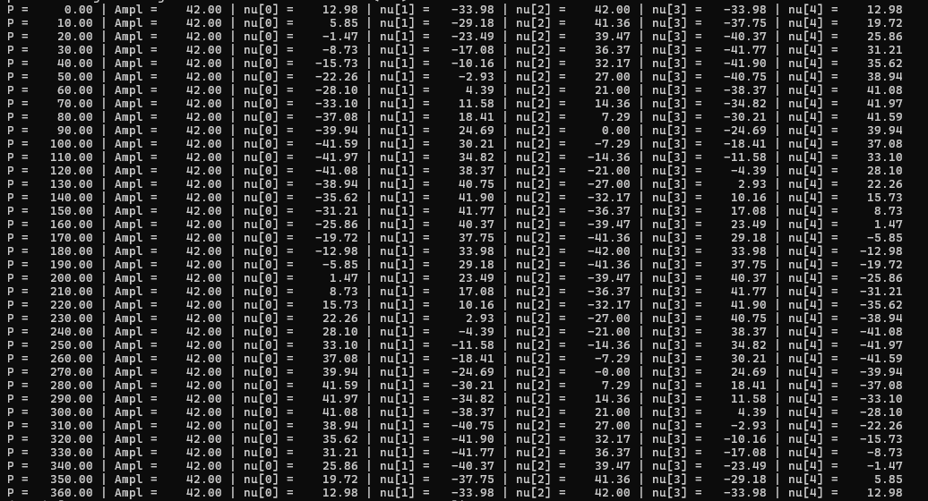

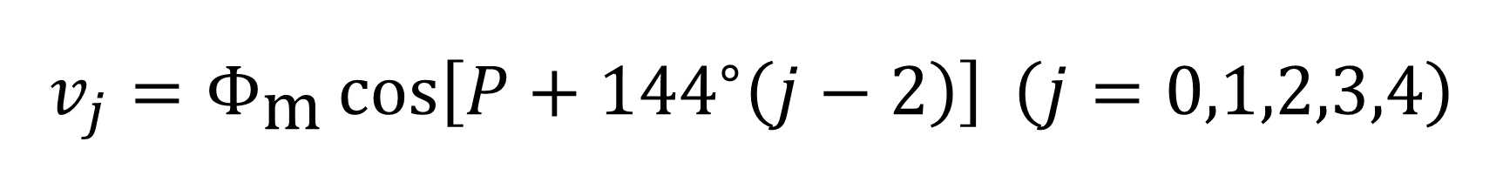
$$v_{j}=Φ_{\text{m}}\cos\left[P+{144}^{∘}\left(j−2\right)\right] \left(j=0,1,2,3,4\right)$$

Slide 6
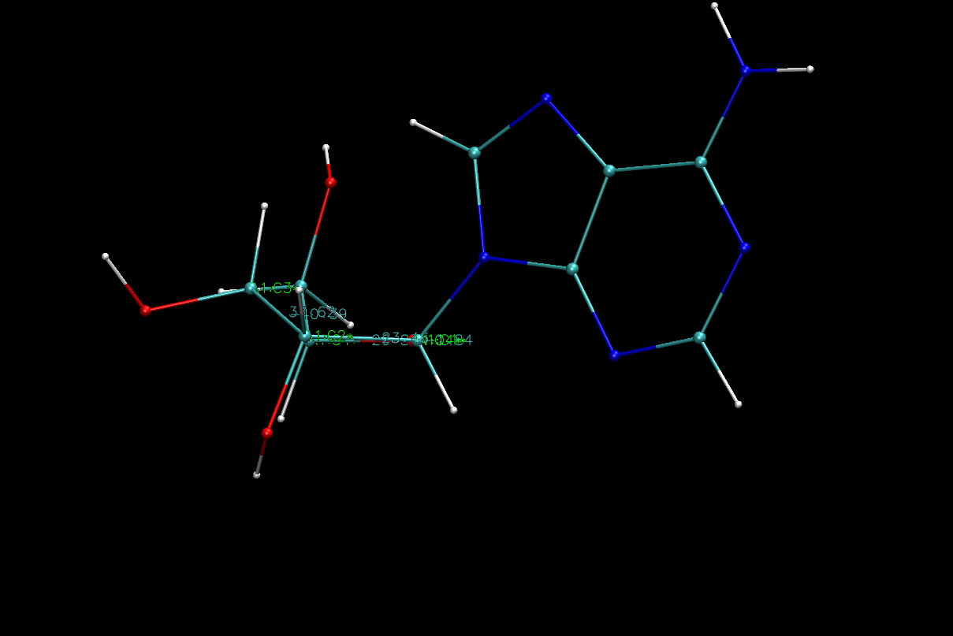
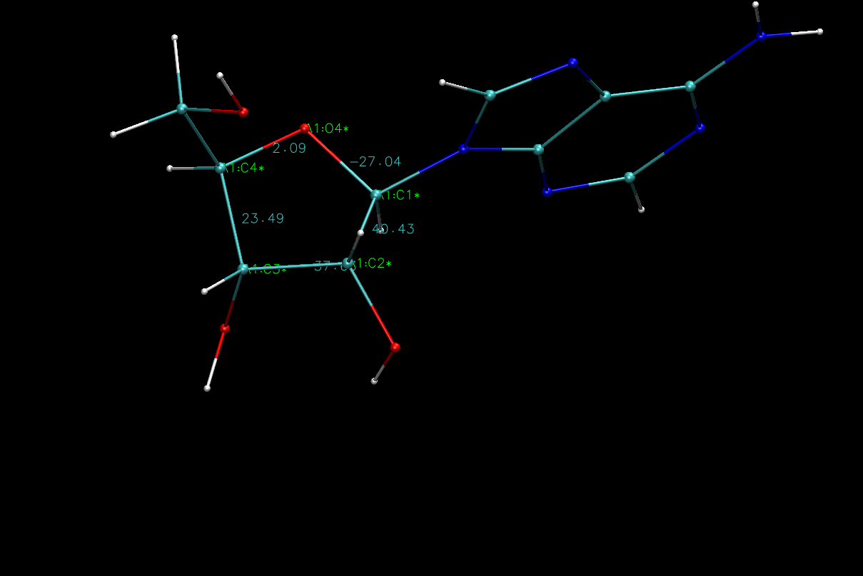

Slide 7
